Slide 1
Web service composition & Techniques
Gerald Masaba
2021/HD05/4116U

Slide 2
Overview
Introduction
Web services
Web service composition
Restful service composition
Composition concern
Composition construct
Cross cutting concerns
Knowledge reuse
Automation level

Slide 3
Introduction
Web services are widely used in various sector business, communication, education, and medicine.
With web service you provide:
Creation of new work processes
Provide access to existing processes
Challenges also exists e.g. human errors or duplicate services

Slide 4
Introduction
A web service contains various servicing components—and more components are being developed
This helps in
in order to provide services to an organization,
to support more complex operations a
to reduce duplicate operations
This led to the development of web composition, where various web services from similar or different services, whether from existing web services or the new service, could be brought together to create a new web composition

Slide 5
Introduction – web composition
Web composition was created to reduce the duplication of service & support increasingly complex nature of servicing components.
Various components were developed to facilitate and support access to and the use of web components.

Slide 6
Automatic web composition
Automation was developed to ensure communication among components, operation control and data transfer and transformation, as well to both eliminate potential error and human error within web components and manage a large quantity of web composition
Automatic web composition can be categorized into:-

Slide 7
WEB SERVICE
A web service allows the use of application software via a network, where an application’s data is exchanged through URL queries
Input is processed and output is given via HTTP protocol, as data is exchanged in the form of XML (SOAP) Web Service Description Language (WSDL) is used to explain the characteristics of the object that is being used for communication

Slide 8
RESTFul Web Service
Mode of web service
Characteristics
1) Understandable: in the RESTFul web service, resources can be acquired by referencing the resource’s name via HTTP protocol
2) Scalable: as resources are accessed via URL, the Restful web service supports server-side operation, caching, alleviation and load balancing.
3) Declarative: the RESTFul web service focuses more on resources’ names than their usage.
4) Lightweight: the RESTFul web service does not require the SOAP protocol. Rather, the service allows lightweight management; that is, it creates a smaller processing burdenand allows stateless operation.

Slide 9
Web Service Composition
Refers to the collection of functions from other web services to create and access machine
This can be creation of existing services or a new service
Lifecycle of web service composition
Service Deployment
Service composition

Slide 10
Service deployment
Concern with preparations of services
This includes:-
Service deployment –Installation & preparation of the application software for further use
Service register - registering a service’s name with the services and registering the names, types and value of each parameter, as well as the type and value of each parameter’s output

Slide 11
Service Composition
This step concerns the process for ﬁnding and creating components
This includes:-
Requests – user request web service components
Definitions - preparation of data from the requested service
Service selection- the selection of components of each activity from the service repository.
Constructed composition service -the components of the selected service will be prepared from the default value of the repository
Service repository-the storage and distribution of services.
Execute composition service -the processing of acquired data
Response data-once the process is complete, data will be returned to the main operation

Slide 12
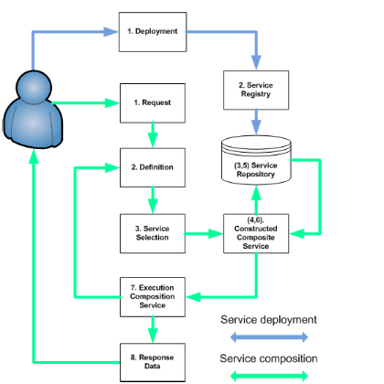
The Life Cycle of Web Service Composition

Slide 13
RESTFul Service – Composition
Gathering the functions of other web services by using characteristics of the RESTFul web service involves several.
It involves the aspect below:-
a) Orchestration- carried out by gathering components internally focusing on central processing and maintaining operation state until the end
b) Choreography -by mainly spreading data into other communication with the general protocol in order to facilitate communication among services

Slide 14
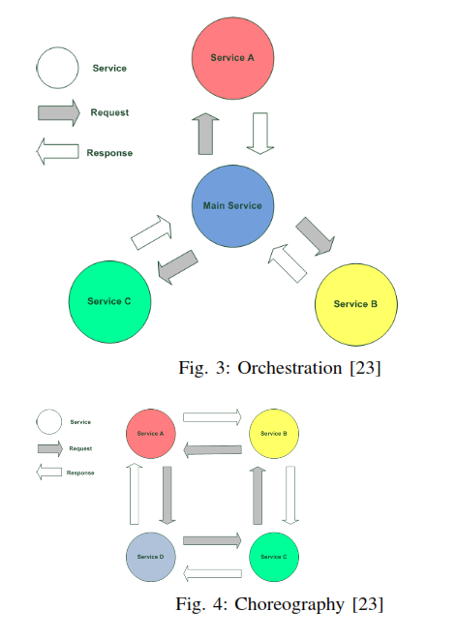
Orchestration vs Choreography
Notes:
a) Orchestration: carried out by gathering components internally, focusing on central processing and maintaining operation state until the end, as described in b) Choreography: by mainly spreading data into other services and focusing on communication with the general protocol in order to facilitate communication among services that are not processing centrally, as shown in Figure 4.

Slide 15
Composition Concerns
1) Component Access: to support access to and the appli-cation of other components that are available to the servicing application, returning such components for accepting service transactions.
2) Conversation Management: to manage communication among components and the hierarchy of components in order to allow the precise and correct transfer of data.
3) Control ﬂow: components’ use order is also important. Therefore, the system will require control over components’ order of operation. For example, the system will wait for component B to ﬁnish its operation, then components C and D may initiate their operations.

Slide 16
Composition Concerns
4) Data Flow: to control the ﬂow of data for the purpose of data communication. This concerns the ﬁrst to the last components that have been initialised, where all components have to be initialised correctly and harmoniously.
5) Data Transformation: to transform data that is being sent and received among components. This is because various types of data, such as XML and JSON, are sent and received among components. Therefore, the system requires the transformation of such data so that it can be used on the intended component. Another mode of data transformation issize, where each component receives a different size of data of the same type.

Slide 17
Composition Constructs
In order to construct the composition, there are several steps in the construction and gathering of service components
These can be organized in 3 categories:
Control flow patterns
Data Flow Patterns
Data Transformation capabilities

Slide 18
Control flow patterns
This step speciﬁes the ﬂow from one component to another, in order fashion, pertaining to the given ﬂow criteria
The legitimate component will be called for and it will return data as a default value for the construction of the new component. This step will be repeated to the end of the service component

Slide 19
Data Flow Patters
The system must also understand the data that each component requires
Previous component that now serves as the input of the current component current component may also require part of the data of the component from another component before the previous one
Solution :categorised into scopes
Data of global scope
Data of session scope
Data of request scope
Notes:
a) Data of global scope: are variables from the server or middleware, such as the IP address or session ID of the entity that called for web service composition.
b) Data of session scope: are variables that occurred once web service composition was initialised and will remain until the end of web service composition.
c) Data of request scope: are variables that occurred once the sub-component was initialised and will remain until the sub-component forwards them away or terminates its operation.

Slide 20
Data transformation capabilities
components from different web services will be different in terms of input and output data
Automated Transformation
Data transformation of the same type and format.
Data transformation of the same type but only partial transformation is required.
Data transformation of different types and the structure of entire data needs to be transformed.
Data transformation of different types but only partial transformation is required.
Semi-automated Transformation
this is a data trans-formation that the user has previously speciﬁed

Slide 21
Crosscutting – Concerns
There are several crosscutting concerns for the preparation of web service composition, ranging from the initiation process to the ﬁnalised process
Exception -web service composition must be able to detect potential errors and analyse the extent that such an error will cause to the operation of the components
Transaction -When these components are initialized from several web service compositions, the major concern for the system is that it has to work correctly with precise data. This is called “Transaction
Security –the security of web service composition begins with entry protection, permission to access web service composition and permission to use each component of each composition
SLA & QoS-an important mutual agreement between the service composition user and the service composition provider
Notes:
d) SLA and QoS: an important mutual agreement between
the service composition user and the service composition
provider [5].

Slide 22
Crosscutting – Concerns
Security –the security of web service composition begins with entry protection, permission to access web service composition and permission to use each component of each composition. The security of web service composition can be divided into four levels:
User Level using authentication with OpenID, single signon, standards for user authentication and authorisation with WS-Security and OAuth.
Message Level using encryption at the service composition provider level and decryption at the service composition consumer level
Service Level protection against thread attacks and denial of service by using access protection and detection, as well as imposing the service provider’s security policy by checking service composition attacks
SLA & QoS-an important mutual agreement between the service composition user and the service composition provider
Notes:
d) SLA and QoS: an important mutual agreement between the service composition user and the service composition
provider [5]. This includes agreements on data transfers, error handling and messages that occur during data transfers in order to reduce
potential errors, response time, data condition and business criteria.

Slide 23
Knowledge Reuse
Reuse is an important and prominent part of service com-position. Reuse contains two parts: reused artifact and reused technique.
Reused Artifact-Once components have been gathered into composition, it can be reused as a composition or reused as a sub-component of another composition in the following ways:
In line
From process fragment
From the aforementioned examples
Reused Technique
Search & discovery
Copy/Paste technique
Cloning technique
Rrecommendation
Notes:
In line: with data transformation rules, data transformation can be used several times in various components.
b) From process fragments: fragments of any composition can become a separated process and do not require another process.
c) From the aforementioned examples: we may also reuse example components or test components for a trial run,
a) Search and Discovery technique: in which there are four search methods, including: - Keyword Search searching for the keyword in the description
ﬁle, repository service description or keyword-augmented search.
- Semi-structured search searching by comparing the structure of the searched object with structures from the XML ﬁle.
- Relational Query Language search.
- Graph-structured search
b) Copy/Paste technique: using the GUI tool to copy an existing component and paste it for further usage.
c) Cloning technique: reusing the component by creating a component from the existing service via the constructor.
d) Recommendation: searching for a recommended system or tool.

Slide 24
Automation Level
We have 3 levels
Manual - the user creates the document, criteria and component, then saves them and instructs the computer to follow the criteria of the web service component;
Automated – Computer is responsible for making a decision on its own by using artiﬁcial intelligence (AI)
Semi Automated- the system and user work collaboratively

Slide 25
Automation Technique
Using an automation technique reduces human error and supports complex operations. There are three automation techniques,as outlined below.
There are three automation techniques:-
Synthesis technique -imitating the target to control the ﬂow and complexity and proportionately solve the problem
Planning technique -creating semantic meaning by using high-level decision-making language
Model-driven development technique-creating semantic meaning by using high-level decision-making language e.g xml .divided into two parts:-
Composition logic
Data Transform
Notes:
a) Composition Logic: this part of service composition uses logic by using symbol or high-level code in order to proceed to the next component, in collaboration with using logic for decision making.
b) Data Transform: this part uses symbol or high-level code in order to transform data into the component. We will now survey all of the aforementioned concerns and techniques, while keeping automation our main focus.

Slide 26
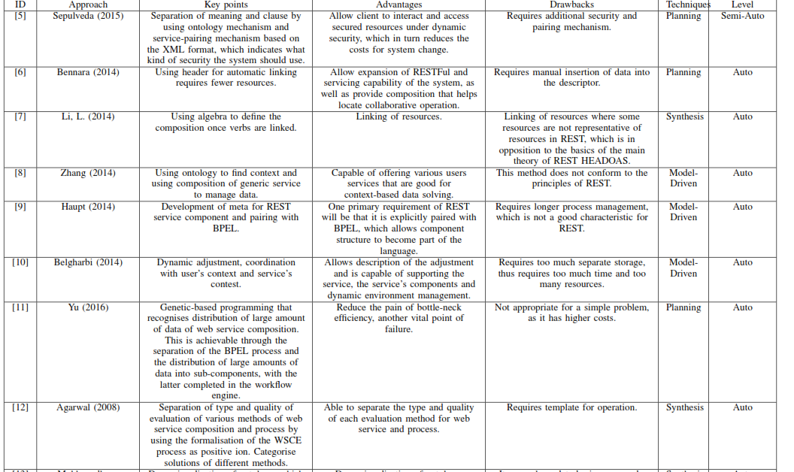
Presentation Technique and Level of RESTFul Web Service Composition
Notes:
Ontology means describing the semantics of the data, providing a uniform way to enable communication by which different parties can understand each other
Business Process Execution Language for Web Services (BPEL or BPEL4WS) is a language used for the definition and execution of business processes using Web services
Wsce -flexible Web Service Composition Environment
is a prototype of autonomic modeling and simulation environment
Web Services Business Process Execution Language (WS-BPEL)

Slide 27
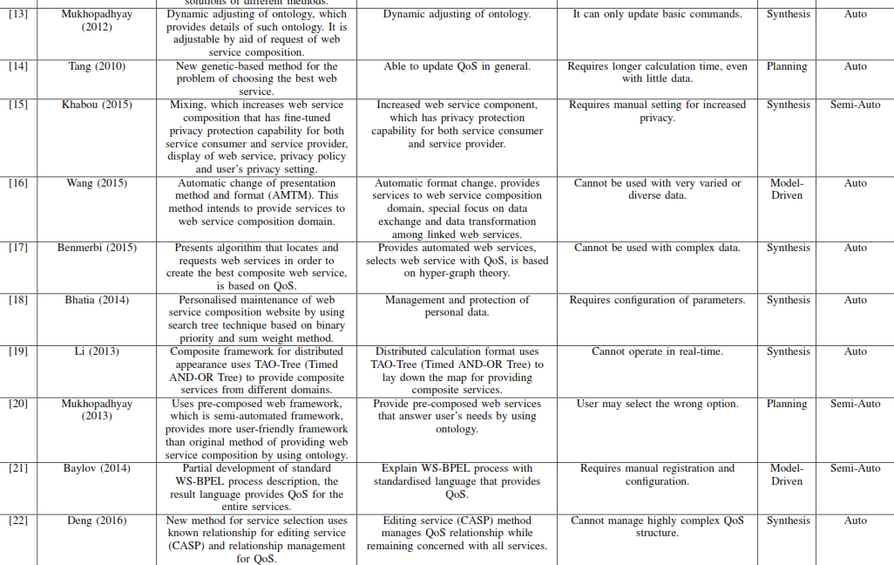
Presentation Technique and Level of RESTFul Web Service Composition

Slide 28
References
K. Sangsanit, W. Kurutach and S. Phoomvuthisarn, "REST web service composition: A survey of automation and techniques," 2018 International Conference on Information Networking (ICOIN), 2018, pp. 116-121, doi: 10.1109/ICOIN.2018.8343096.
Sepulveda, C., R. Alarcon, and J. Bellido, QoS aware descriptions for RESTful service composition: security domain. World Wide Web, 18(4): p. 767-794. 2015.

Slide 29
Thank you for your patience!!

